Slide 1

KGiSL INSTITUTE OF TECHNOLOGY
COIMBATORE
DEPARTMENT OF computer science & engineering
Project phase review
SMART TRAFFIC MANAGEMENT SYSTEM-IOT
Team Members:
711719104075 Ranjani M
711719104087 Sellamani S
711719104090 Shifa Rukshana B
711719104304 Kirana S
Under the guidance of :
Ms. Aruna T N, AP/CSE

Slide 2

agenda
Abstract
Existing System
Literature Survey
Proposed System
Module Split-up
Expected Outcome
References
Timeline

Slide 3
abstract
As the population and number of cars in towns grow, traffic congestion is one of the most pressing problems. In addition to adding to the delay and stress experienced by drivers, traffic jams also result in higher fuel usage and air pollution. Despite appearing to be present everywhere, megacities are the ones most impacted by it. For improved signal control and efficient traffic management, the road traffic density must be calculated in real-time due to the road traffic's ever-increasing volume. One of the key elements influencing how traffic moves is the traffic controller. So, in order to better meet this growing demand, traffic management needs to be optimised. In order to calculate traffic density, our suggested system will use real-time images from the cameras at traffic intersections.

Slide 4
EXISTING SYSTEM
Traffic congestion mainly focuses on the signals failure, reduced law enforcement and improper traffic management.
the existing foundation cannot be expanded further, the only option is to improve traffic management..
Many ways have been developed to manage traffic and reduce congestion.
DRAWBACKS
counting the number of vehicles may give faulty results when space between the vehicles on the road are very small
It needs regular maintance.

Slide 5
literature survey
S.No | Published Year | Paper Title | Authors | Description
1 | 2019 | Traffic Signal Control Using Deep Reinforcement Learning | Wei Dai et al | This study proposes a deep reinforcement learning framework for optimizing traffic signal control. The researchers trained a deep Q-network (DQN) to learn the optimal signal timings by considering traffic conditions and historical data. The results demonstrated improved traffic flow and reduced congestion..
2 | 2018 | "Real-Time Traffic Flow Prediction Using Convolutional Neural Networks" | Zhiyong Cui et al. | The researchers developed a CNN-based model to predict traffic flow patterns in real-time. By analyzing historical traffic data and considering external factors, such as weather and time of day, the model accurately predicted traffic flow. The predictions were used to optimize signal timings and improve traffic management.
3 | 2018 | "Deep Learning-Based Traffic Signal Control for Smart Cities | y Hongkyu Park et al. | This study proposes the use of long short-term memory (LSTM) recurrent neural networks to predict traffic flow patterns. By analyzing historical traffic data, the model accurately predicted future traffic conditions. The predictions were utilized for optimizing traffic signal timings and managing traffic flow.

Slide 6
literature survey
S.No | Published Year | Paper Title | Authors | Description
4 | 2020 | "A Survey of Deep Learning Approaches for Traffic Sign Recognition | Fahad A. AlAtabani et al | The researchers propose a smart traffic control system that combines deep reinforcement learning and image processing techniques. The system detects vehicles using image processing, predicts traffic flow using LSTM networks, and optimizes signal timings using deep reinforcement learning. The results showed improved traffic management and reduced congestion.
5 | 2018 | "Deep Learning-Based Traffic Control for Intelligent Transportation Systems”. | Qiang Yu et al. | This study presents a deep learning-based traffic control system for intelligent transportation systems. The system utilizes a combination of CNNs and RNNs to detect and predict traffic flow. The predicted traffic conditions are then used to optimize signal timings for efficient traffic management.

Slide 7
PROPOSED SYSTEM
As a concept, intelligent traffic systems were designed to provide traffic managers with real-time and predictive insights about traffic flow speeds and traffic congestion/incidents.
ADVANTAGES
Reducing congestion through optimised traffic control is said to be the main influencing factor of change.
Smart traffic management uses digital technologies to manage traffic, based on real-time data to reduce congestion, and minimise emissions.

Slide 8
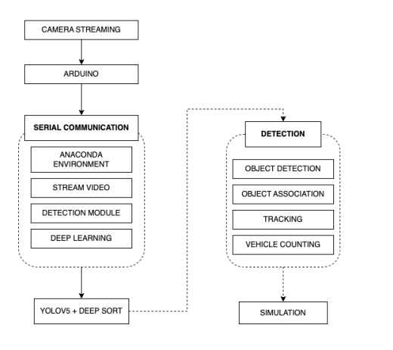
ARCHITECTURE DIAGRAM

Slide 9
MODULES SPLITUP
Module 1: Setup
Module 2: OLED Display
Module 3: Displaying Total Detected vehicles & Timer
Module 4: Turning on Green Light After Timer Complited

Slide 10
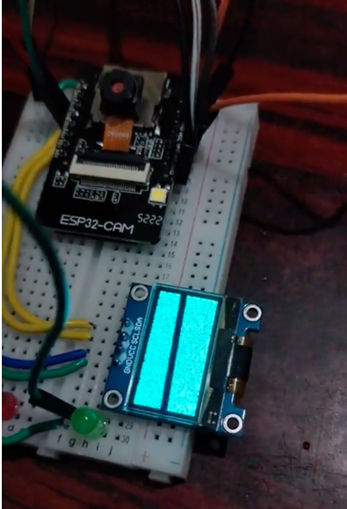
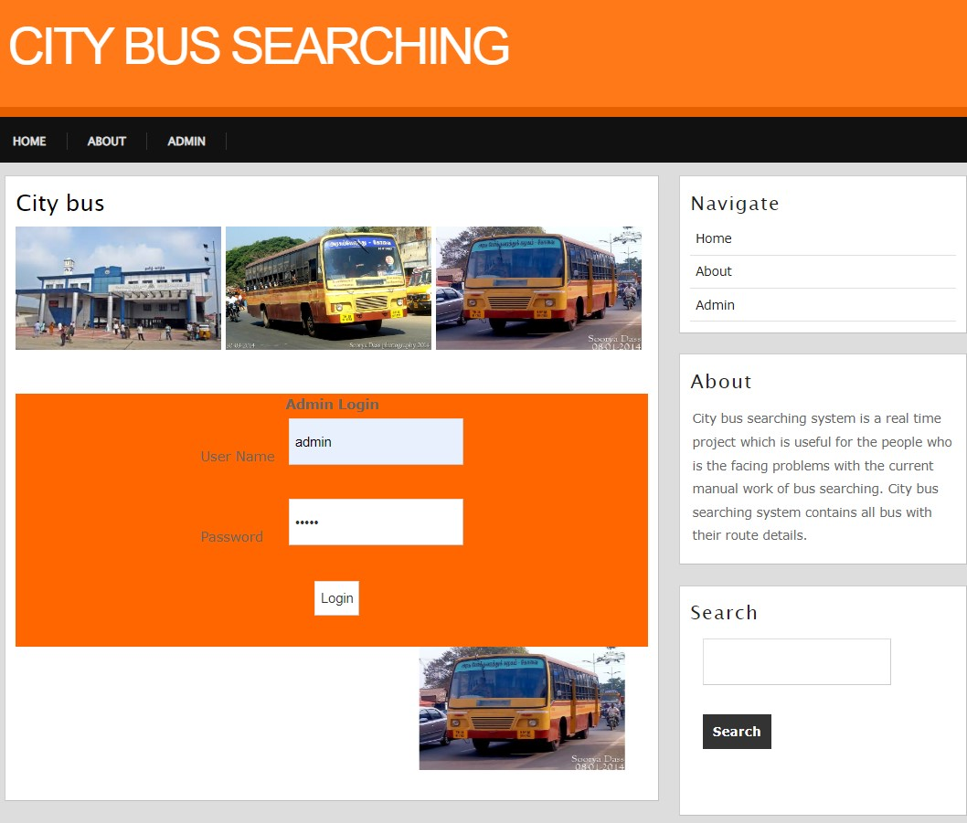
setup

Slide 11
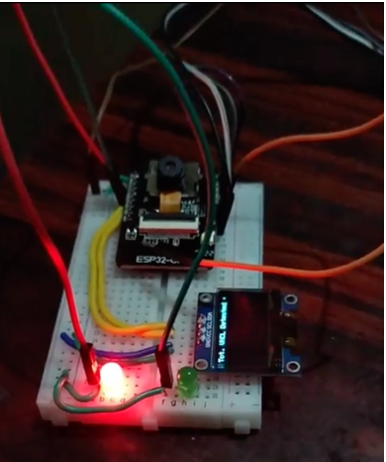
Oled display

Slide 12
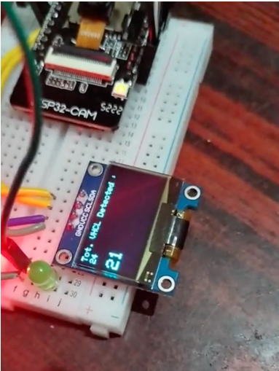
Displaying total detected vehicles & timer

Slide 13
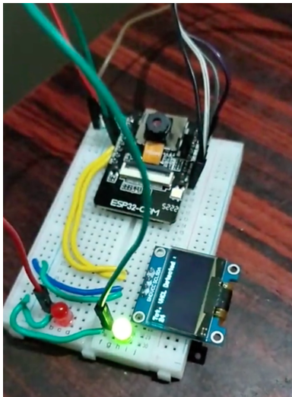
Turning on green light after timer completed

Slide 14
CONCLUSION
Traffic light timing in real-time: The smart traffic management system helps traffic light to operate in real-time conditions. Traffic operates based on traffic congestion automatically. Safety from road accidents: Due to the deployment of this system, the chances of road accidents can be minimized.
The proposed work focuses on Smart Traffic management System using AI which will eliminate the drawbacks of the existing system such as high implementation cost, dependency on the environmental conditions, etc. The proposed system aims at effective management of traffic congestion. It is also cost effective than the existing system.

Slide 15
REFERENCEs
[1] Dipak K Dash, TNN May 31, 2012. ―India loses Rs 60,000 crore due to traffic congestion: Study‖. Times Of India. http://articles.timesofindia.indiatimes.com/2012-05 31/india/31920307_1_toll-plazas-road-space-stoppage
[2] Azeem Uddin, Draft, 23 March 2009. Traffic congestion in Indian cities: Challenges of a Rising power. http://www.visionwebsite.eu/UserFiles/File/filedascaricare/Scientifci%20Partners,Papers%28Kyoto%29/Draft_koc_Azeem%20Uddin.pdf .
[3] FHWA-HRT-06-108. October 2006. Traffic Detector Handbook: Third Edition—Volume I. http://www.fhwa.dot.gov/publications/research/operations/its/06108/
[4] US7245220 B2. Jul 17, 2007. Radio frequency identification (RFID) controller. http://www.google.com/patents/US7245220
[5] FHWA-RD-96-100. July 1995. Detection Technology: IVHSVolume1.http://ntl.bts.gov/DOCS/96100/index.html

Slide 16
REFERENCEs
[6] Li Xun, Nan Kaikai, Liu Yao , ZuoTao “A Real-Time Traffic Detection Method Based on Improved Kalman Filter” , 2018 3rd International Conference on Robotics and Automation Engineering (ICRAE) Guangzhou, China, 17-19 November 2018.
[7] Prof. S. T. Dumbre¹, Panchal Siddhi Santosh² Thakur Tejashri Chandrashekhar Smart traffic management system using machine learning, March. 2022.
[8] Zahra Zamani, Mohammad HosseinSaraee, Mahmoud Pourmand," Application of Data Mining in Traffic Management: Case of City of Isfahan", IEEE 2010.
[9] Celine Jacob, Baher, "Abdulhai Integrated Traffic Corridor Control Using Machine Learning", IEEE2005.
[10]Soufiene Djahel, Mazeiar Salehie, Irina Tal, Pooyan Jamshidi, "Adaptive Traffic Management for Secure and Efficient Emergency Services in Smart Cities", IEEE PerCom conference 2013.

Slide 17
TIMELINE
Particulars | Feb-23 |  |  |  | Mar-23 |  |  |  | Apr-23 |  |  |  | May-22
 | Wk1 | Wk2 | Wk3 | Wk4 | Wk1 | Wk2 | Wk3 | Wk4 | Wk1 | Wk2 | Wk3 | Wk4 | Wk1 | Wk2 | Wk3 | Wk4
Problem Identification
Literature Survey
Module 1
Module 2
Module 3
Testing
Thesis Draft
Final Thesis
Viva

Slide 18
THANK YOU

